Slide 1


Genetic Optimization of Fuzzy C-Means Clustering-Based Fuzzy Neural Networks
Ha-Rang Kim
25.6.01
ⓒSaebyeol Yu. Saebyeol’s PowerPoint

Slide 2
Table of contents
1
GA (Genetic Algorithm)
2
Background
3
Algorithm
4
Experiment

Slide 3
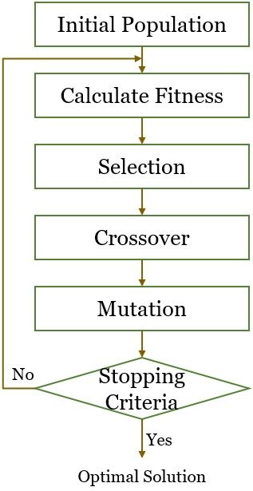

GA (Genetic Algorithm)
Select superior solution
Search various alternatives
Escape the local optima

Slide 4
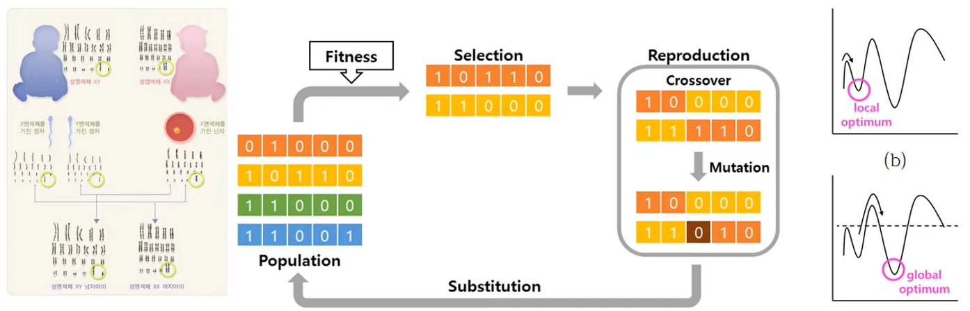
GA (Genetic Algorithm)

Slide 5
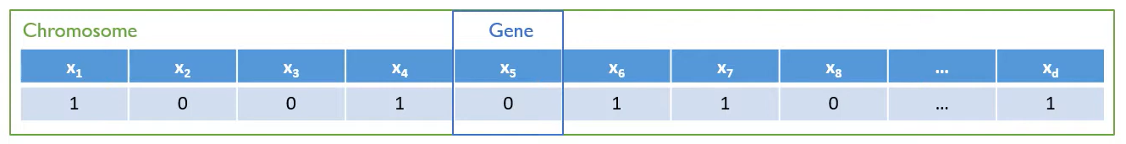
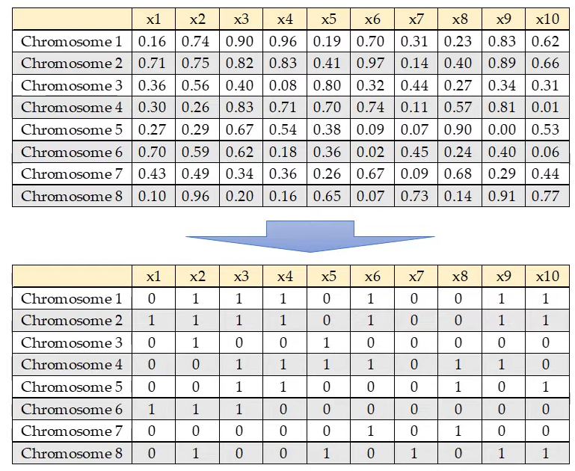

GA (Genetic Algorithm)
1. Initiation
Encoding chromosomes – binary encoding
$$xεR^{d}$$
<Hyper parameter>
- The number of chromosome (population size)
- Fitness function (quality of chromosome)
- Crossover mechanism
- The rate of mutation
- Stop criteria (min fitness improvement, max iterations)
Random number
Cut off= 0.5

Slide 6
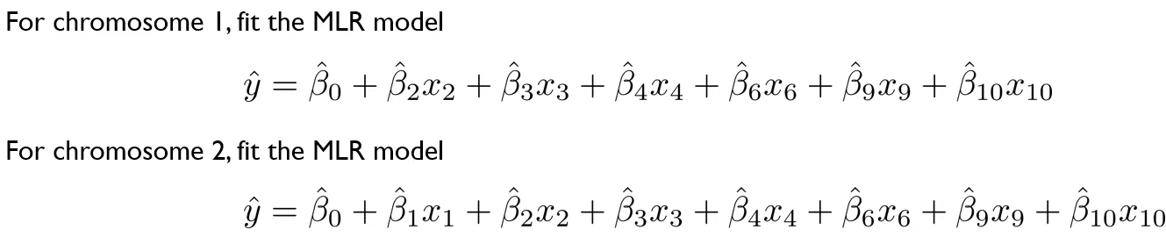
GA (Genetic Algorithm)
1. Initiation - modeling
(Number of chromosome = Number of model)

Slide 7
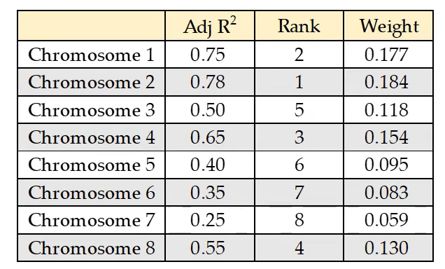
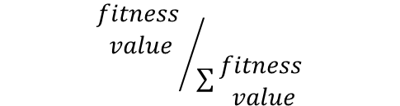
GA (Genetic Algorithm)
2. Fitness Evaluation
Criterion that determines which chromosomes are better than others
- Accuracy better -> Fitness value better (ex: 1-RMSE)
- Higher fitness -> better chromosomes
$${\begin{aligned}fitness \\ value\end{aligned}}/{\sum{\begin{aligned}fitness \\ value\end{aligned}}}$$
If two chromosome have same fitness value
=> Fewer variable

Slide 8
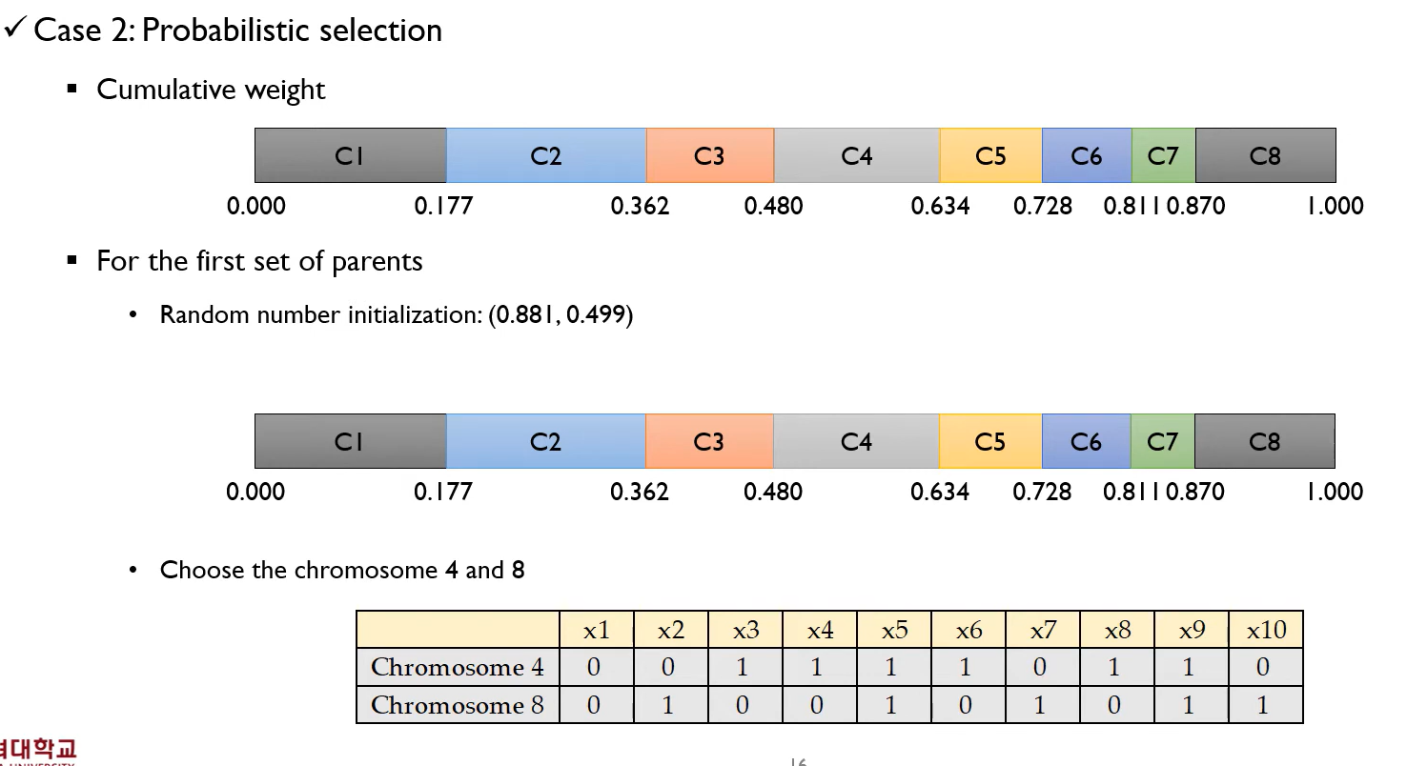


GA (Genetic Algorithm)
3. Selection
Deterministic selection
-top N% (bottom(100-N)% chromosomes are never selected)
Probabilistic Selection
-All chromosomes can be selected with different probabilities (weight)

Slide 9
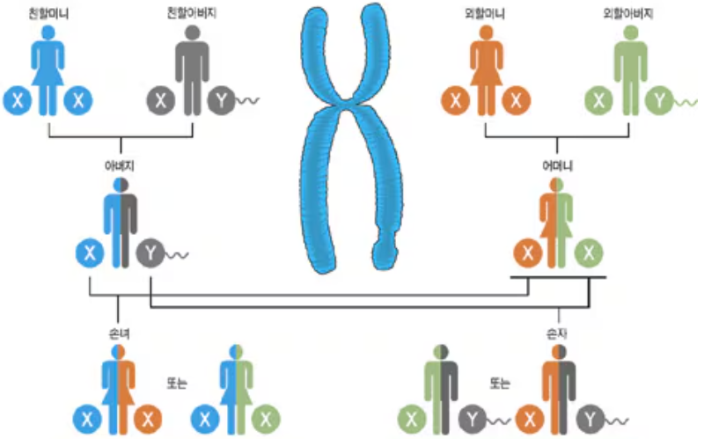
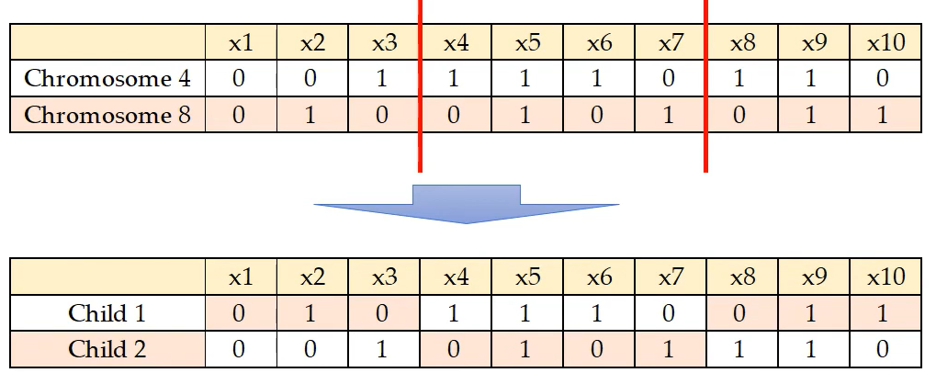
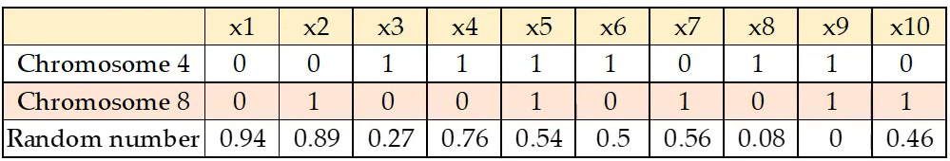
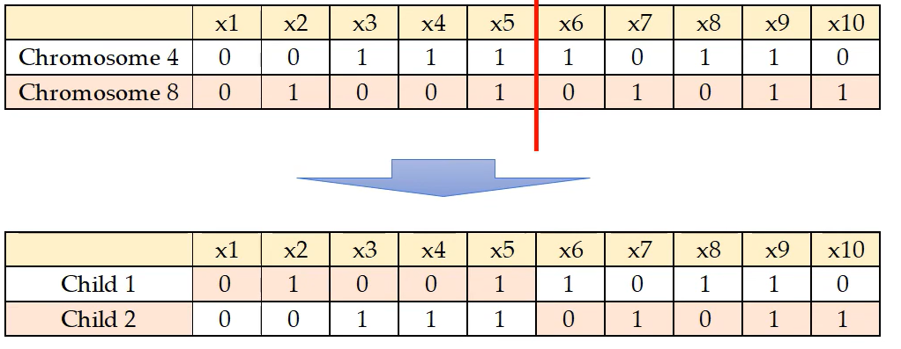
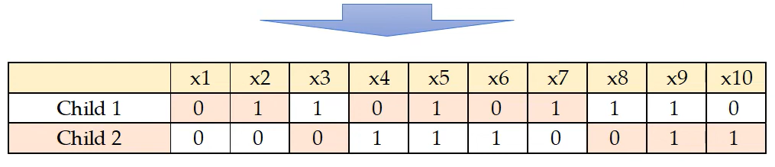


GA (Genetic Algorithm)
4. Crossover & Mutation
Crossover point: 2
Crossover point: 10?
Crossover point: 1

Slide 10
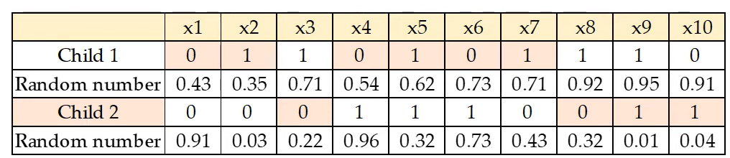
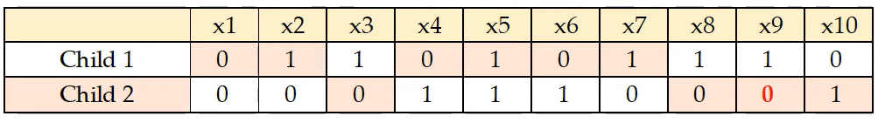

GA (Genetic Algorithm)
4. Crossover & Mutation

Slide 11
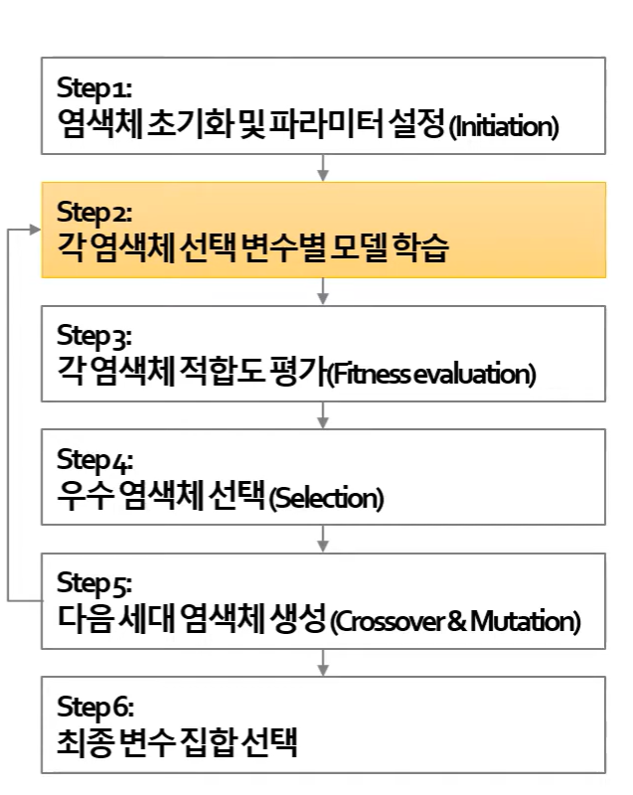
GA (Genetic Algorithm)

